Slide 1
Unit- IV
Topic: Servlets

Slide 2
What is Servlets?
Java Servlets are programs that run on a Web or Application server and act as a middle layer between a requests coming from a Web browser or other HTTP client and databases or applications on the HTTP server.
Using Servlets, you can collect input from users through web page forms, present records from a database or another source, and create web pages dynamically.

Slide 3
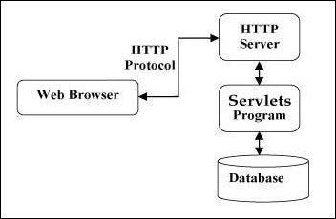
Servlet Architecture

Slide 4
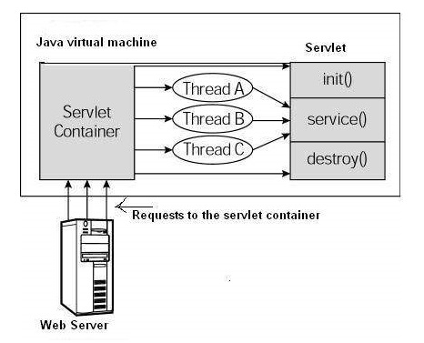
Servlet Life Cycle Diagram
First the HTTP requests coming to the server are delegated to the servlet container.
The servlet container loads the servlet before invoking the service() method.
Then the servlet container handles multiple requests by spawning multiple threads, each thread executing the service() method of a single instance of the servlet.

Slide 5
Servlet Life Cycle
The servlet is initialized by calling the init() method.
The servlet calls service() method to process a client's request.
The servlet is terminated by calling the destroy() method.
Finally, servlet is garbage collected by the garbage collector of the JVM

Slide 6
The init() Method
The init method is called only once.
It is called only when the servlet is created, and not called for any user requests afterwards.
So, it is used for one-time initializations.
When a user invokes a servlet, a single instance of each servlet gets created, with each user request resulting in a new thread that is handed off to doGet or doPost as appropriate.
The init() method simply creates or loads some data that will be used throughout the life of the servlet.
The init method definition looks like this −
public void init() throws ServletException {
// Initialization code… }

Slide 7
The service() Method
The service() method is the main method to perform the actual task.
The servlet container (i.e. web server) calls the service() method to handle requests coming from the client( browsers) and to write the response back to the client.
When server receives a request for a servlet, the service() method checks the HTTP request type (GET, POST) and calls doGet, doPost, methods as appropriate.
Here is the signature of this method −
public void service(ServletRequest request, ServletResponse response)
throws ServletException, IOException { }

Slide 8
The doGet() Method
A GET request results from a normal request for a URL or from an HTML form that has no METHOD specified and it should be handled by doGet() method.
public void doGet(HttpServletRequest request, HttpServletResponse response)
throws ServletException, IOException {
// Servlet code
}

Slide 9
The doPost() Method
A POST request results from an HTML form that specifically lists POST as the METHOD and it should be handled by doPost() method.
public void doPost(HttpServletRequest request, HttpServletResponse response)
throws ServletException, IOException {
// Servlet code
}

Slide 10
The destroy() Method
The destroy() method is called only once at the end of the life cycle of a servlet.
This method gives your servlet a chance to close database connections, halt background threads, and perform other such cleanup activities.
After the destroy() method is called, the servlet object is marked for garbage collection.
The destroy method definition looks like this −
public void destroy() {
// Finalization code...
}

Slide 11
Example 1- To Print Hello World directly
import java.io.*;
import javax.servlet.*;
import javax.servlet.http.*;
public class HelloWorld extends HttpServlet {
public void init() throws ServletException { }
public void doGet(HttpServletRequest request, HttpServletResponse response) throws ServletException, IOException
{
response.setContentType("text/html");
PrintWriter out = response.getWriter();
out.println("<h1> Hello World </h1>");
}
public void destroy() { }
}

Slide 12
Reading Form Data using Servlet
getParameter() − You call request.getParameter() method to get the value of a form parameter.
getParameterValues() − Call this method if the parameter appears more than once and returns multiple values, for example checkbox.
getParameterNames() − Call this method if you want a complete list of all parameters in the current request.

Slide 13
Example 2- To read data from HTML file and print that .
It requires 2 files:
1. HTML (s1.html)File
2. Servlet (s2.java) File
First Run HTML file and after clicking on submit button it will run servel(.java) file.

Slide 14
Example 2- To read data from HTML file and print that .
S1.html (html code)
<html>
<form method=“post” action=“s2”>
Enter Your Name
<input type=text name=“t1”>
<br>
<input type=“submit” value=“submit”>
</form>
</body>
</html>

Slide 15
Example 2- To read data from HTML file and print that .
S2.java (Servlet Code)
import java.io.*;
import javax.servlet.*;
public class s2 extends HttpServlet {
public void doPost(HttpServletRequest request, HttpServletResponse response) throws ServletException, IOException
{
response.setContentType("text/html");
String a= request.getParameter("t1");
PrintWriter out= response.getWriter();
out.print("<br>Your Name is: "+a);
}
}

Slide 16
Session Tracking (Management)
Session Tracking is a way to maintain state (data) of an user. It is also known as session management in servlet.
Http protocol is a stateless so we need to maintain state using session tracking techniques.
Each time user requests to the server, server treats the request as the new request.
So we need to maintain the state of an user to recognize to particular user.
Why use Session Tracking?
To recognize the user It is used to recognize the particular user.

Slide 17
Session Tracking Techniques
Cookies
Hidden Form Field
URL Rewriting
HttpSession

Slide 18
Session Tracking- Using Cookies
A cookie is a small piece of information that is persisted between the multiple client requests.
A cookie has a name, a single value, and optional attributes such as a comment, path and domain qualifiers, a maximum age, and a version number.
How Cookie works
In cookies technique, we add cookie with response from the servlet. So cookie is stored in the cache of the browser. After that if request is sent by the user, cookie is added with request by default. Thus, we recognize the user as the old user.

Slide 19
Session Tracking- Using Cookies
Types of Cookie
Non-persistent cookie
Persistent cookie
Non-persistent cookie
It is valid for single session only. It is removed each time when user closes the browser.
Persistent cookie
It is valid for multiple session . It is not removed each time when user closes the browser. It is removed only if user logout or sign out.

Slide 20
Session Tracking- Using Cookies
Advantage of Cookies
Simplest technique of maintaining the state.
Cookies are maintained at client side.
Disadvantage of Cookies
It will not work if cookie is disabled from the browser.
Only textual information can be set in Cookie object.

Slide 21
Session Tracking- Using Cookies
Useful Methods of Cookie class
Method | Description
public void setMaxAge(int expiry) | Sets the maximum age of the cookie in seconds.
public String getName() | Returns the name of the cookie. The name cannot be changed after creation.
public String getValue() | Returns the value of the cookie.
public void setName(String name) | changes the name of the cookie.
public void setValue(String value) | changes the value of the cookie.

Slide 22
Session Tracking- Using Cookies
How to create Cookie?
Cookie ck=new Cookie("user","sonu"); //creating cookie object
response.addCookie(ck); //adding cookie in the response

Slide 23
Session Tracking- Using Cookies
How to delete Cookie?
Cookie ck=new Cookie("user","") ;//deleting value of cookie
ck.setMaxAge(0); //changing the maximum age to 0 seconds
response.addCookie(ck); //adding cookie in the response

Slide 24
Session Tracking- Using Cookies
How to get Cookies?
Cookie ck[]=request.getCookies();
for(int i=0; i<ck.length; i++){
out.print("<br>"+ck[i].getName()+" "+ck[i].getValue()); //printing name and value of cookie
}

Slide 25
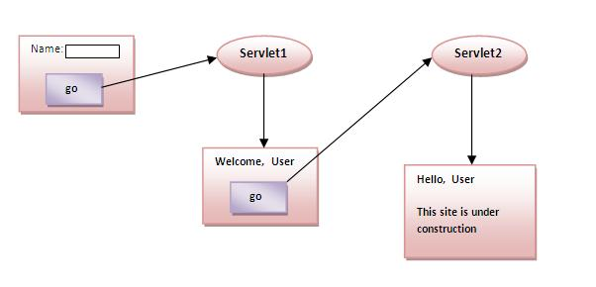
Session Tracking- Using Cookies Simple example of Servlet Cookies

Slide 26
Session Tracking- Using Cookies Simple example of Servlet Cookies
index.html
<form action="servlet1" method="post">
Name:<input type="text" name="userName"/><br/>
<input type="submit" value="go"/>
</form>

Slide 27
Session Tracking- Using Cookies Simple example of Servlet Cookies
Servlet1.java
try{
String n=request.getParameter("userName");
out.print("Welcome "+n);
Cookie ck=new Cookie("uname",n); //creating cookie object
response.addCookie(ck); //adding cookie in the response
//creating submit button
out.print("<form action='servlet2'>");
out.print("<input type='submit' value='go'>");
out.print("</form>");
out.close();
}

Slide 28
Session Tracking- Using Cookies Simple example of Servlet Cookies
Servlet2.java
{
response.setContentType("text/html");
PrintWriter out = response.getWriter();
Cookie ck[]=request.getCookies();
out.print("Hello "+ck[0].getValue());
out.close();
}

Slide 29
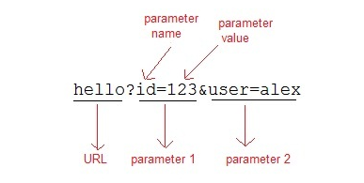
Session Tracking- URL Rewriting
If the client has disabled cookies in the browser then session management using cookie wont work.
In that case URL Rewriting can be used as a backup. URL rewriting will always work.
In URL rewriting, a token(parameter) is added at the end of the URL.
The token consist of name/value pair separated by an equal(=) sign.
For Example:

Slide 30
Session Tracking- URL Rewriting
When the User clicks on the URL having parameters, the request goes to the Web Container with extra bit of information at the end of URL.
The Web Container will fetch the extra part of the requested URL and use it for session management.
The getParameter() method is used to get the parameter value at the server side.
Advantage of URL Rewriting
It will always work whether cookie is disabled or not (browser independent).
Extra form submission is not required on each pages.
Disadvantage of URL Rewriting
It will work only with links.
It can send only textual information.

Slide 31
Session Tracking- URL Rewriting
index.html
<form method="post" action="validate">
Name:<input type="text" name="user" /><br/>
Password:<input type="text" name="pass" ><br/>
<input type="submit" value="submit">
</form>

Slide 32
Session Tracking- URL Rewriting
Validate.java
{
response.setContentType("text/html;charset=UTF-8");
String name = request.getParameter("user");
String pass = request.getParameter("pass");
if(pass.equals("1234")) {
response.sendRedirect("First?user_name="+name+"");
}

Slide 33
Session Tracking- URL Rewriting
First.java
{
response.setContentType("text/html;charset=UTF-8");
PrintWriter out = response.getWriter();
String user = request.getParameter("user_name");
out.println("Welcome "+user);
}
}

Slide 34
Servlet- Data Storage
Almost all web applications (servlets or related dynamic web server software) store and retrieve data –
Typical web app uses a data base management system (DBMS)
Another option is to use the file system

Slide 35
Servlet: Concurracy
One common web application problem: concurrency

Slide 36
Servlet: Concurracy
Concurrency means multiple computations are happening at the same time.
•Ex: Web browser loading several images at the same time, or web browser can respond to your mouse clicks while it is still downloading information from a web server are examples of concurrent processing in action on the client side.
•On a server side, multiple requests to the same servlet may be executed at the same time. So concurrency container or web server is multithreaded.

Slide 37
Servlet: Concurracy
A thread is a single execution process.
It is a basic unit of CPU utilization, consisting of own program counter, a stack, and a set of registers.
A program is multithreaded when multiple threads execute a single instance of a program.

Slide 38
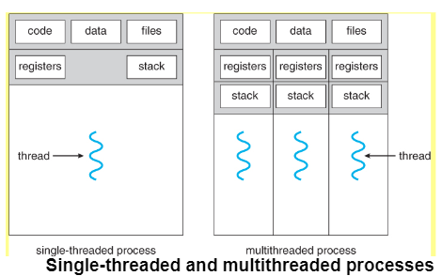
Servlet: Concurracy

Slide 39
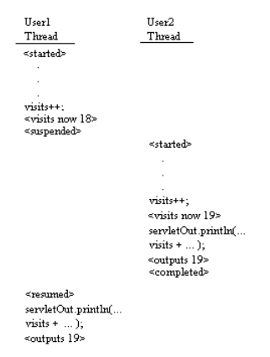
Threading Issues
Two threads running in HelloCounter concurrently.
The initial value of visits is assumed to be 17.

Slide 40
Thread Synchronization
A servlet must be capable of serving more than one client at a time.
If several clients issue requests at the same time, methods will serve each client in a different thread.
service( ), doGet( ), and doPost( ) can handle many concurrent clients.
It uses lock mechanism to synchronize the threads.

Slide 41
Topic: Ajax

Slide 42
AJAX
What is AJAX?
AJAX = Asynchronous JavaScript And XML.
AJAX is not a programming language.
AJAX just uses a combination of:
A browser built-in XMLHttpRequest object (to request data from a web server)
JavaScript and HTML DOM (to display or use the data)

Slide 43
AJAX - Technologies
AJAX cannot work independently. It is used in combination with other technologies to create interactive webpages.
JavaScript
Loosely typed scripting language.
JavaScript function is called when an event occurs in a page.
Glue for the whole AJAX operation.
DOM
API for accessing and manipulating structured documents.
Represents the structure of XML and HTML documents.
CSS
Allows for a clear separation of the presentation style from the content and may be changed programmatically by JavaScript
XMLHttpRequest
JavaScript object that performs asynchronous interaction with the server.

Slide 44
AJAX – Real Time Examples
Here is a list of some famous web applications that make use of AJAX.
Google Maps
A user can drag an entire map by using the mouse, rather than clicking on a button.
Google Suggest
As you type, Google offers suggestions. Use the arrow keys to navigate the results.
Gmail
Gmail is a webmail built on the idea that emails can be more intuitive, efficient, and useful.
Yahoo Maps (new)
Now it's even easier and more fun to get where you're going!

Slide 45
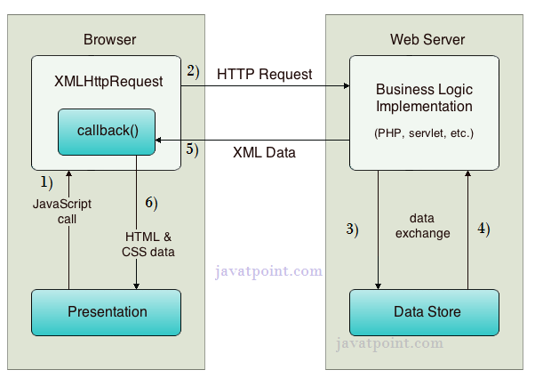
How AJAX Works

Slide 46
AJAX Processing Steps
Steps of AJAX Operation
A client event occurs.
An XMLHttpRequest object is created.
The XMLHttpRequest object is configured.
The XMLHttpRequest object makes an asynchronous request to the Webserver.
The Webserver returns the result containing XML document.
The XMLHttpRequest object calls the callback() function and processes the result.
The HTML DOM is updated.

Slide 47
AJAX Example – table.html
<html>
<head>
<script>
var request;
function sendInfo() {
var v=document.f1.t1.value;
var url="index.jsp?val="+v;
if(window.XMLHttpRequest){
request=new XMLHttpRequest();
}
request.onreadystatechange=getInfo;
request.open("GET",url,true);
request.send();
}
function getInfo(){
if (request.readyState==4) {
var val=request.responseText;
document.getElementById('amit').innerHTML=val;
}
}
</script>
</head>
<body>
<h1>This is an example of ajax</h1>
<form name=“f1">
<input type="text" name="t1">
<input type="button" value="ShowTable" onClick="sendInfo()">
</form>
<span id="amit"> </span>
</body>
</html>

Slide 48
AJAX Example- index.jsp
<%
int n=Integer.parseInt(request.getParameter("val"));
for(int i=1;i<=10;i++)
out.print(i*n+"<br>");
%>

Slide 49
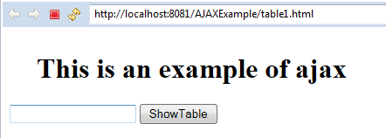
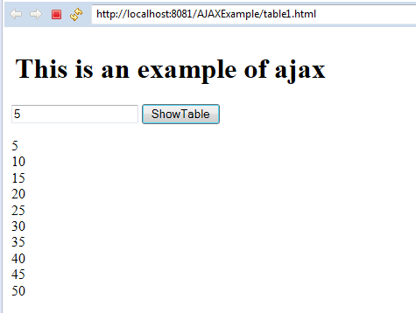
AXAX Example output

